Slide 1

Centre for Development of Advanced Computing, Bengaluru
“Feedback Report Generation
System”

Slide 2
ABOUT TEAM
Dhruti Vachhani
Chetana Patil
Smitaraj Shastri
Shreya Burhade

Slide 3
Outline
Introduction
Objective
Specifications
Flow Diagram for Admin
Flow Diagram for Student
UML Diagram
ER Diagram
Snapshots
Relational Database schema
Database Table Snapshots

Slide 4
Introduction
“Feedback Report Generation System” is web-based application.
Feedback system provide feedback easy and quick manner.
Web –application designed to collect and manage feedback from student for different courses.
This web-application used for both teacher and student.
System collects and analyzes feedback data
Generate reports that provide an overall evaluation of the course and the teacher.

Slide 5

Objective
To find effective and fast way to collect about the faculty from student
To Collect and analyze the data
To generate overall evolution report for particular course and teacher.

Slide 6
Specifications
SOFTWARE SPECIFICATIONS
Platform – Intellij IDEA
Technologies : Java, Spring Boot, React JS, Hibernate,HTML,CSS
Database : MySQL
Server -Tomcat
Google Chrome
HARDWARE SPECIFICATIONS
Intel Pentium 4 Processor
512 MB RAM
20 GB Hard Disk

Slide 7
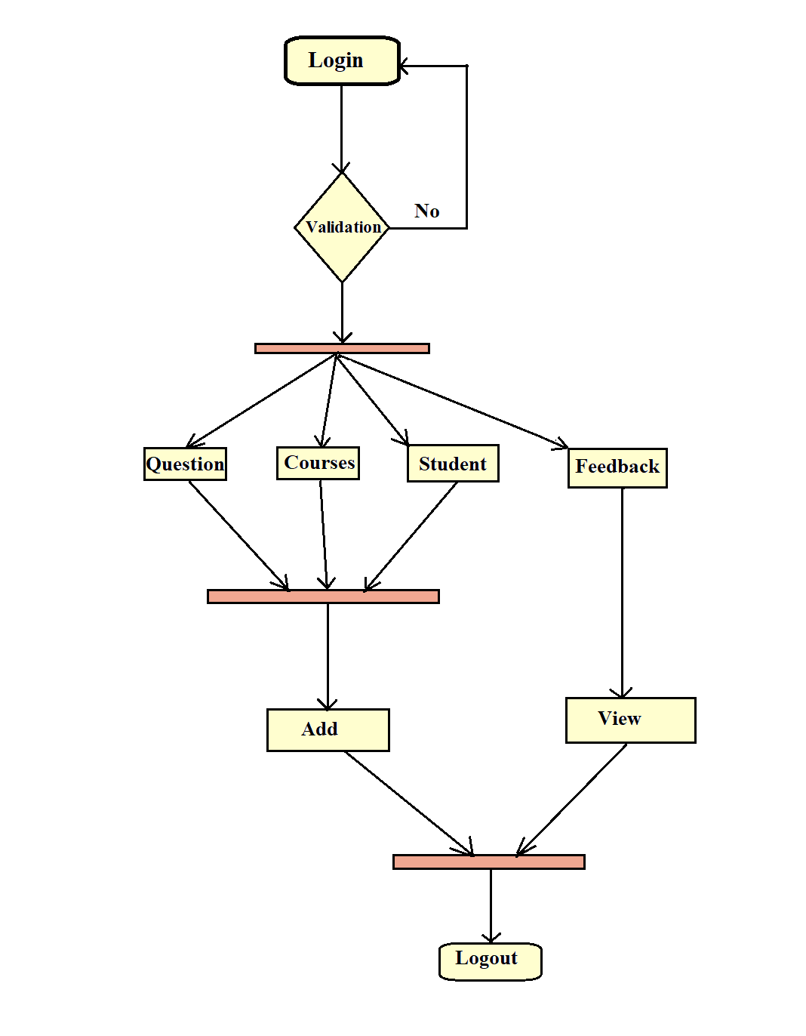
Flow Diagram for Admin

Slide 8
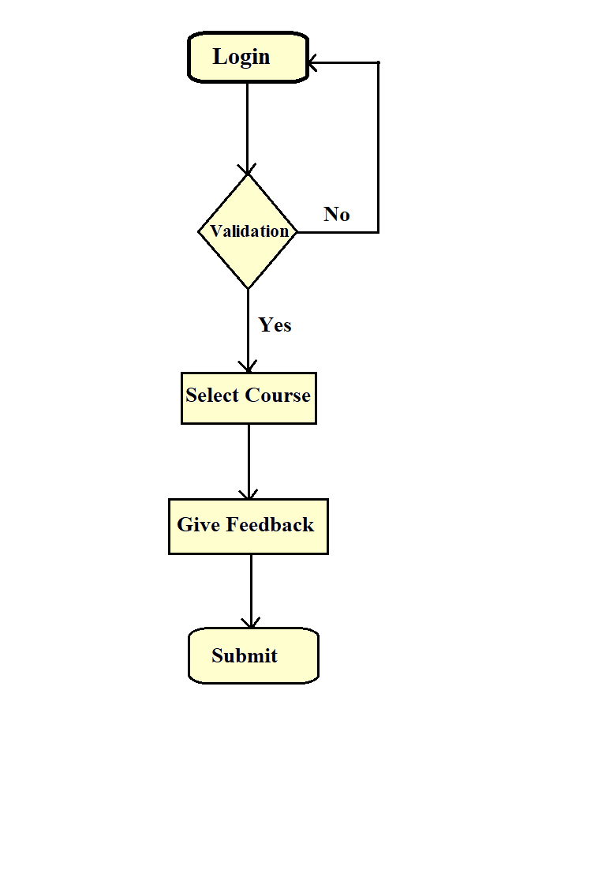
Flow Diagram for Student

Slide 9
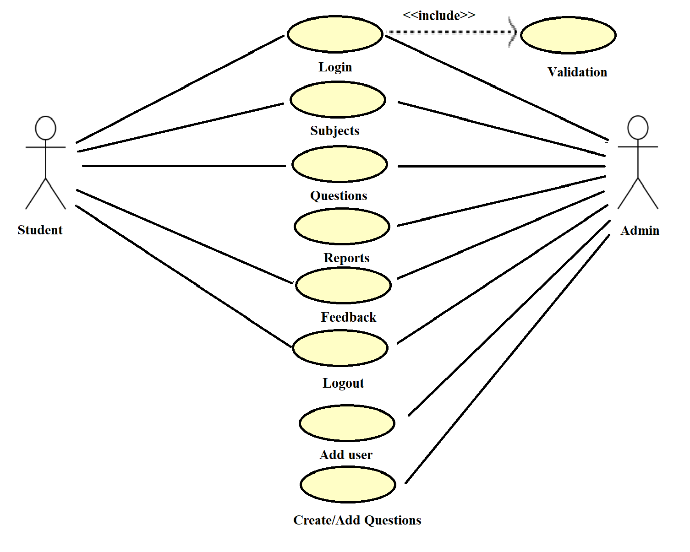
UML Diagram

Slide 10
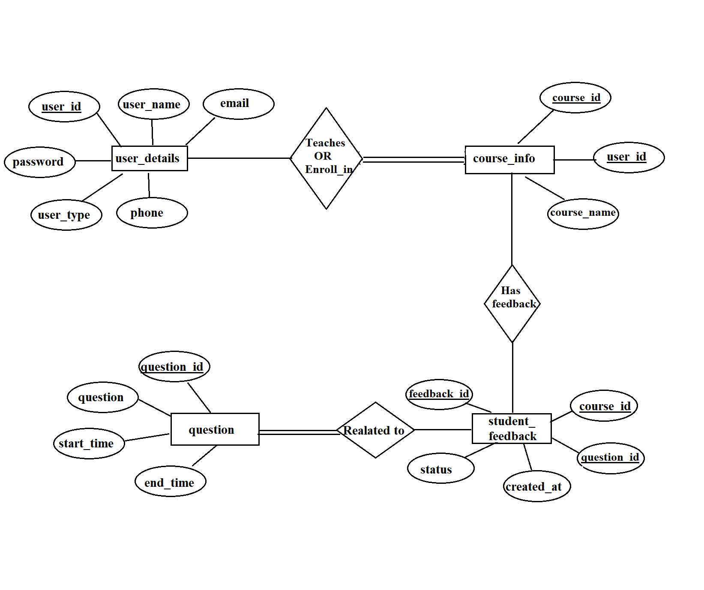
ER Diagram

Slide 11
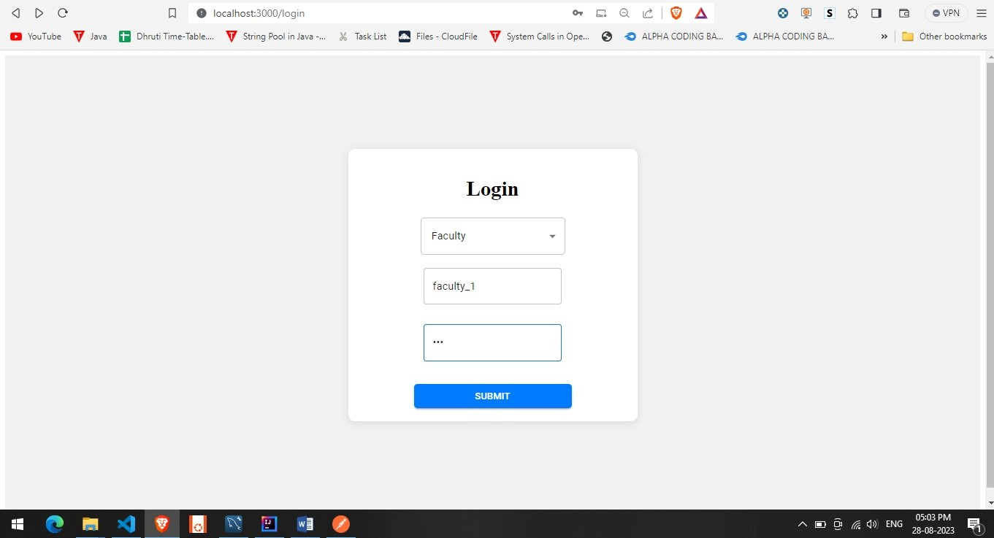
Snapshots-Login Page:

Slide 12
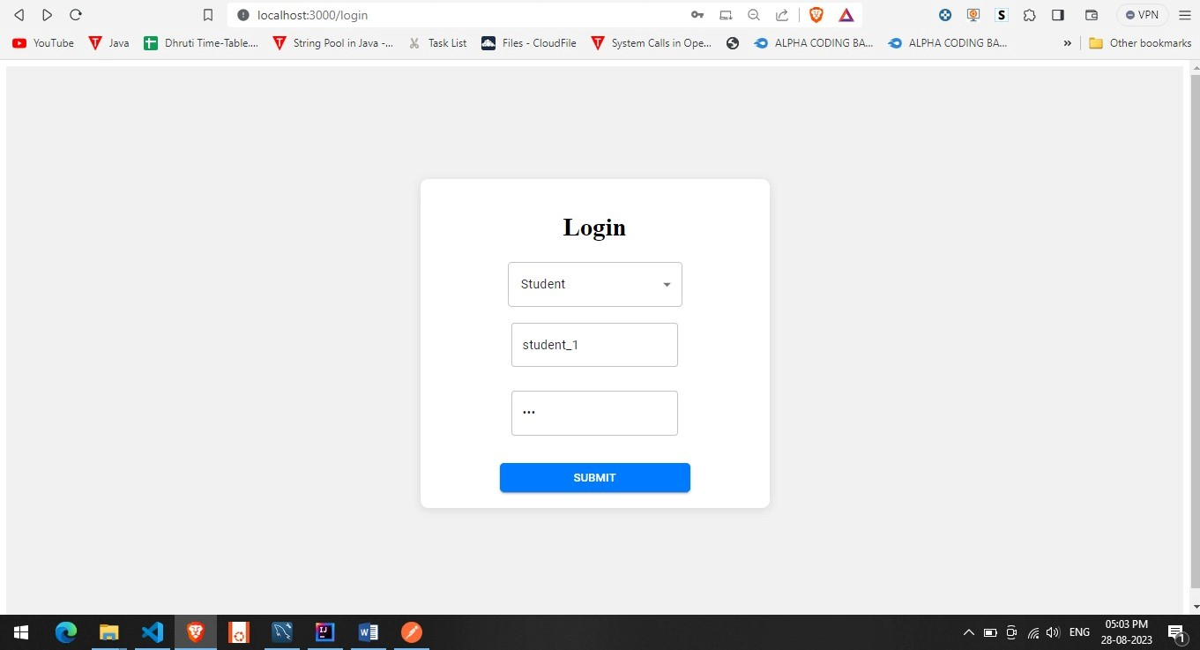
Faculty Login:

Slide 13
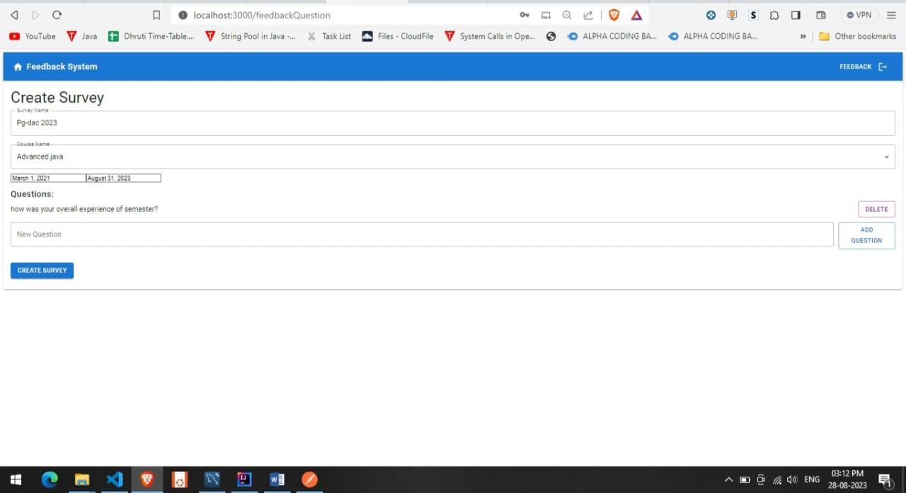
Feedback Create page:

Slide 14
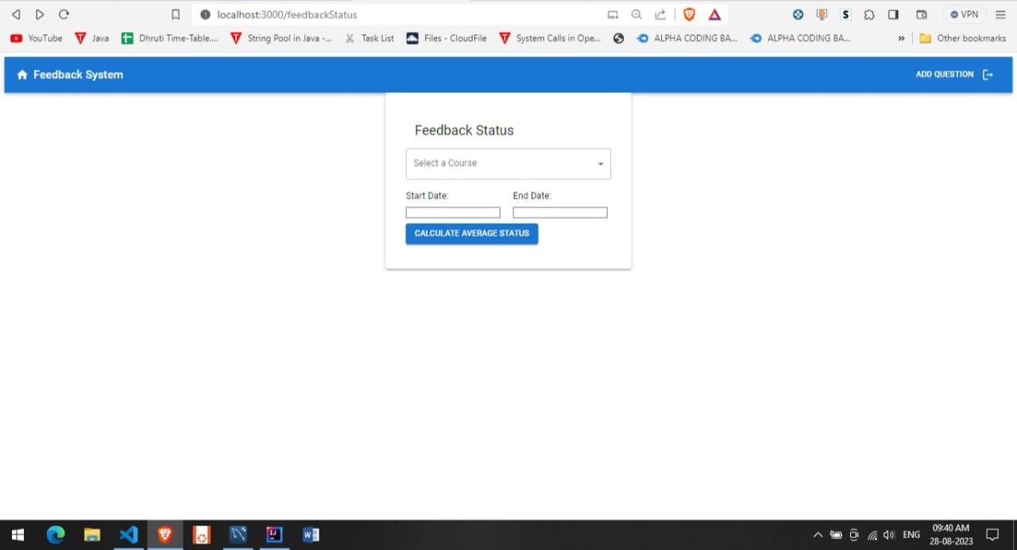
Create Survey :

Slide 15
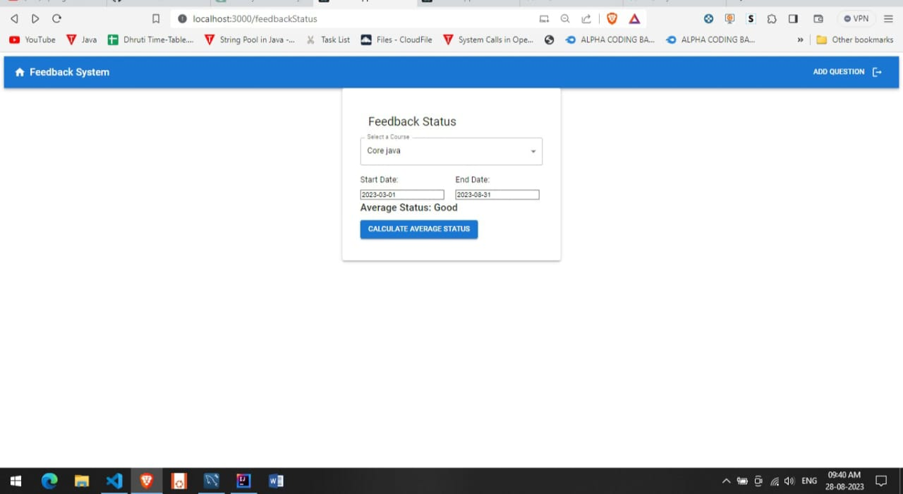
Feedback Status:

Slide 16
Student Login :

Slide 17
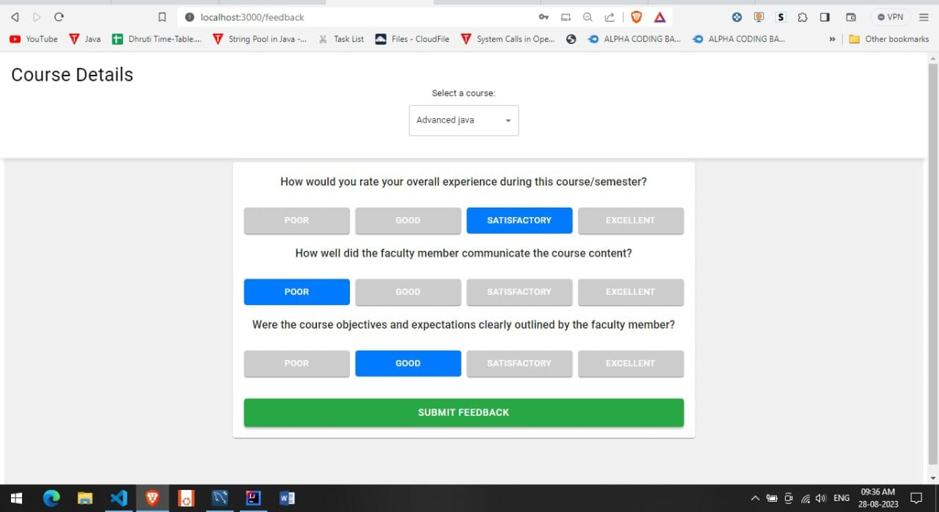
Feedback Questions:

Slide 18
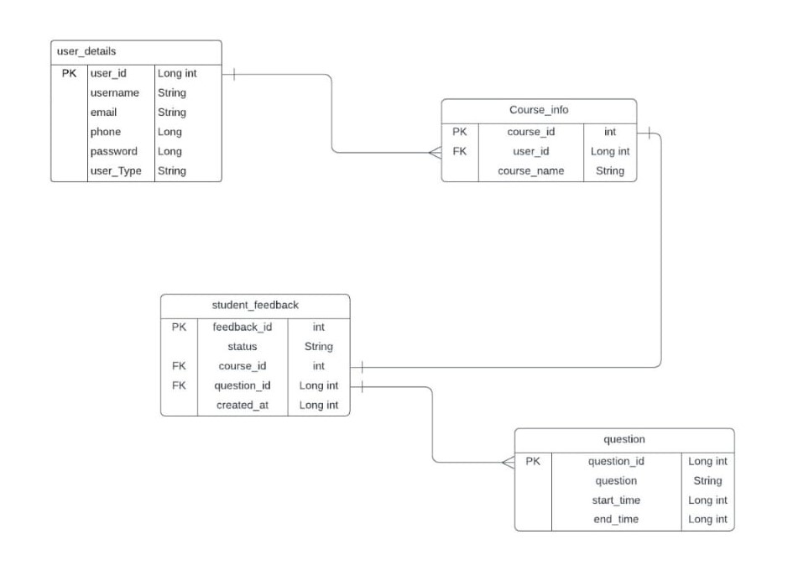
Relational Database Schema

Slide 19
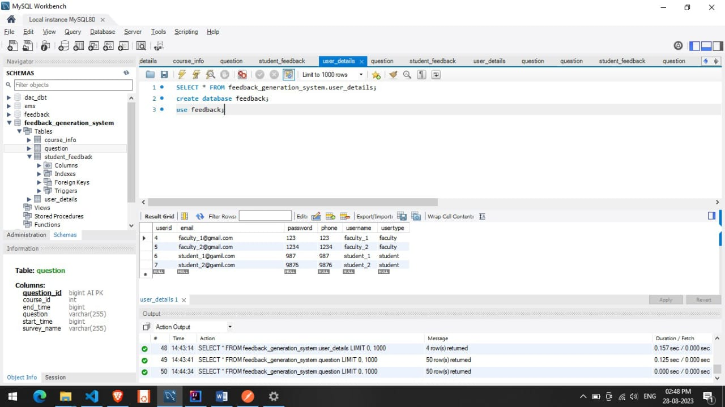
User Details :

Slide 20
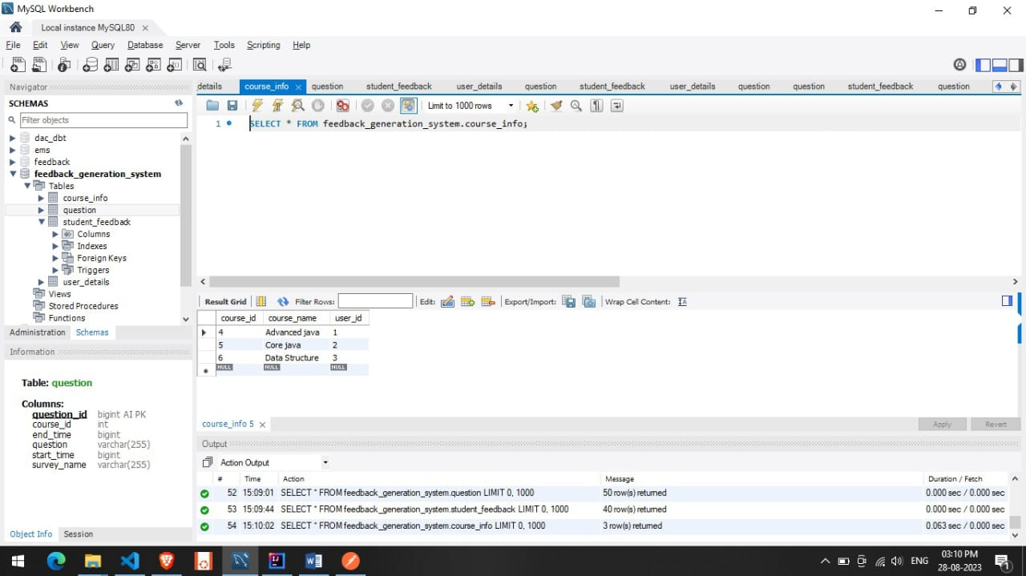
Course_info

Slide 21
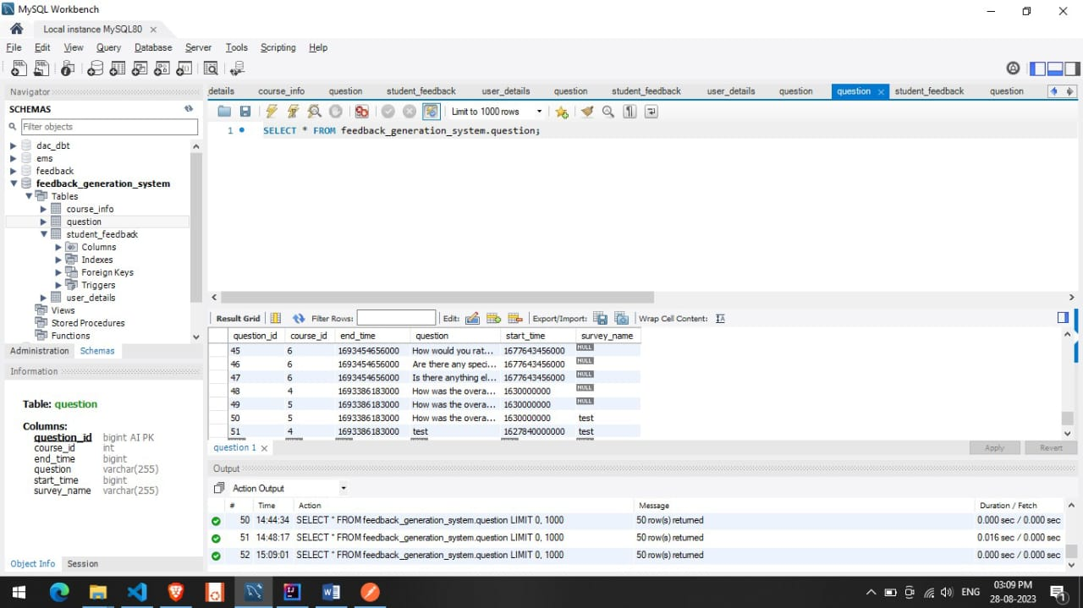
Question:

Slide 22
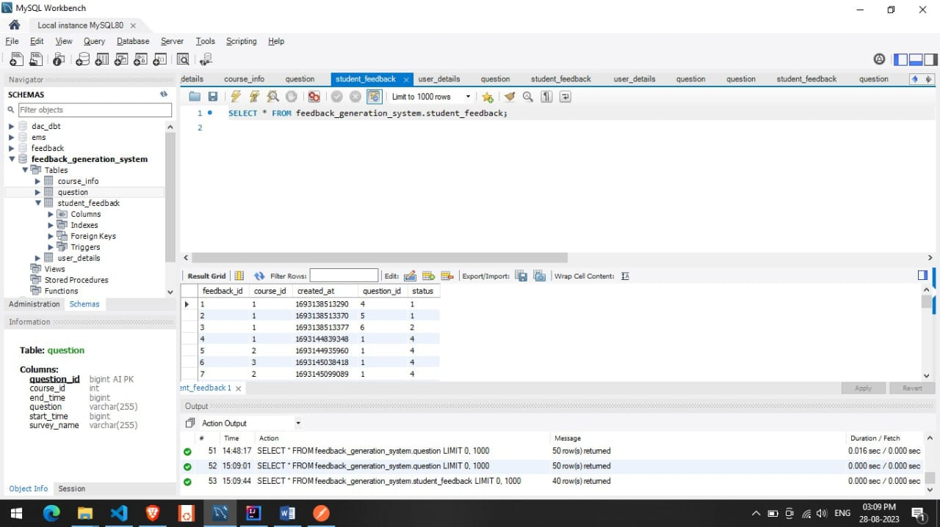
Student Feedback:

Slide 23



